Slide 1

Accidents Analysis & Prediction
Group 4
2019.5.14

Slide 2
6,000
PART ONE
Machine Learning
标题数字等都可以通过点击和重新输入进行更改，顶部“开始”面板中可以对字体、字号、颜色、行距等进行修改。
Liu Yang

Slide 3
My tasks
Data preprocessing (2-3 Days)
Prediction (5-6 Days)
Data cleaning(pandas),Dimensionality reduction(PCA)
sklearn,tenserflow,knn(predicting deaths)
neural network(predict the probability of an accident)
Analyze data (3-4 Days)
Provide data interface(2-3 Days)
pandas,matplotlib,provide data needed for front-end visualization
python,pandas,csv to json

Slide 4
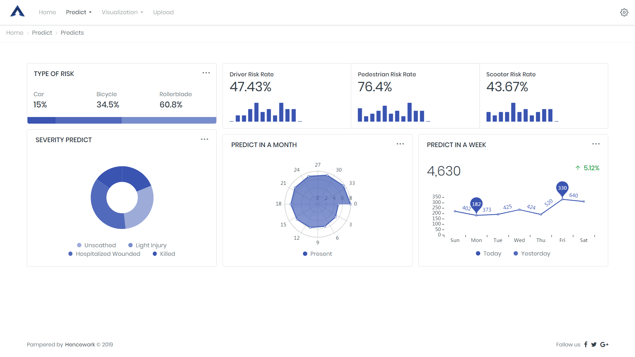
Visualization of prediction results

Slide 5
Risks
model
It is difficult to find a more appropriate and accurate machine learning model
No dataset without accident
When predicting the probability of an accident, we only have an accident dataset but no dataset without an accident condition. Randomly generated reverse data sets may lead to inaccurate predictions

Slide 6
PART TWO
Controller & View
Li Zhaohui

Slide 7
· GUI (7-11 Days)
html, css, jquery, bootstrap
· Interaction between front and back end (2-3 Days)
python, flask, jquery
·Translation (2-3 Days)
jquery, cookies/localstorage, json
English, Chinese & French,
·Web Server deployment (3-4 Days)
linux, nginx, gunicorn

Slide 8
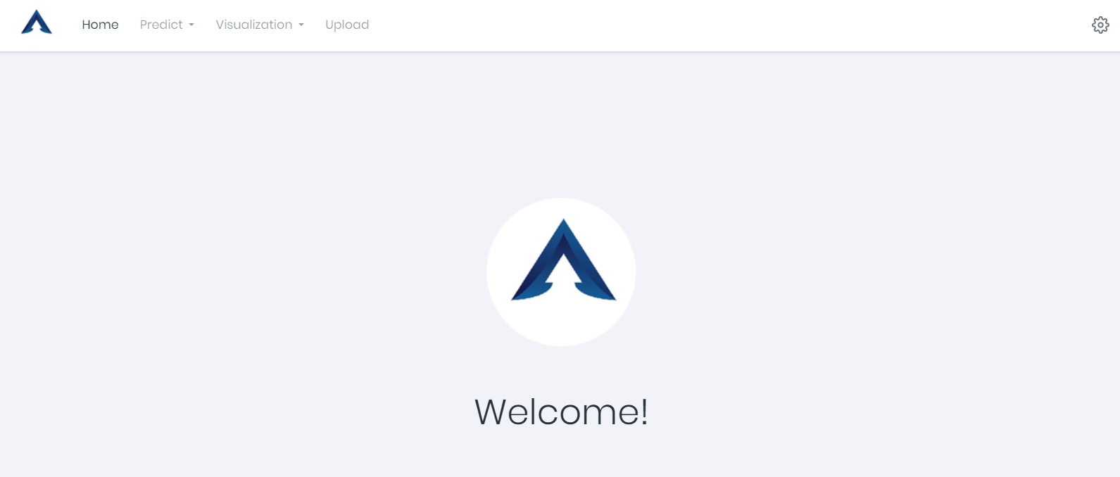
The GUI Demo

Slide 9
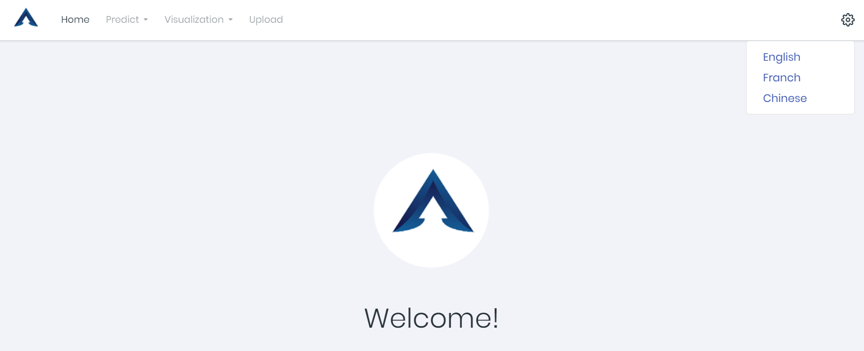
The GUI Demo

Slide 10
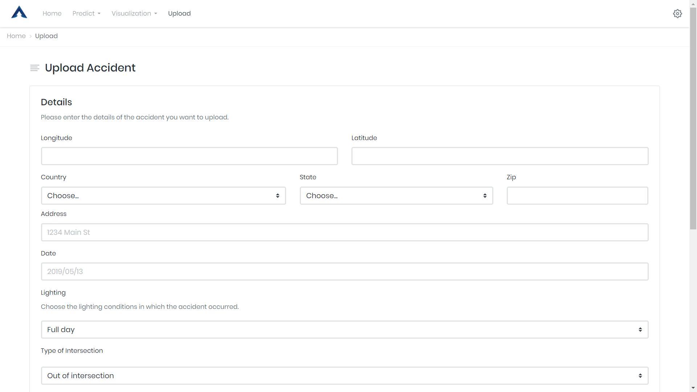
The GUI Demo

Slide 11
RISK
·The interface between front and back end
·Cross-origin resource sharing（CORS）
·The details of accident are difficult to collect

Slide 12
PART THREE
Analysis with Visualization
He Shuhao

Slide 13
Analysis with Visualization - Tools
Python
Matplotlib
HTML+CSS+JS
JQuery
Geocoding
JSON
Baidu Map
Google Maps
OpenStreetMap
GEOJSON
Baidu ECharts
Google Charts
D3

Slide 14
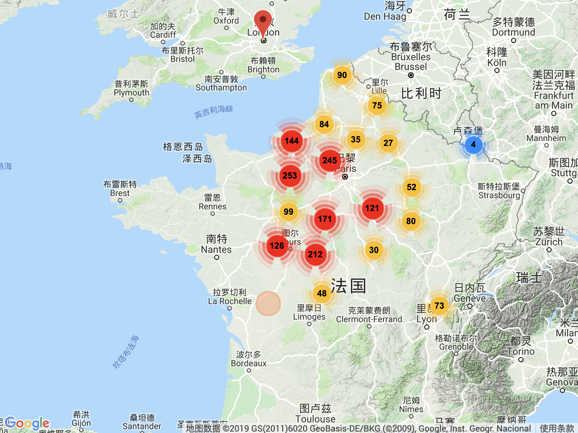
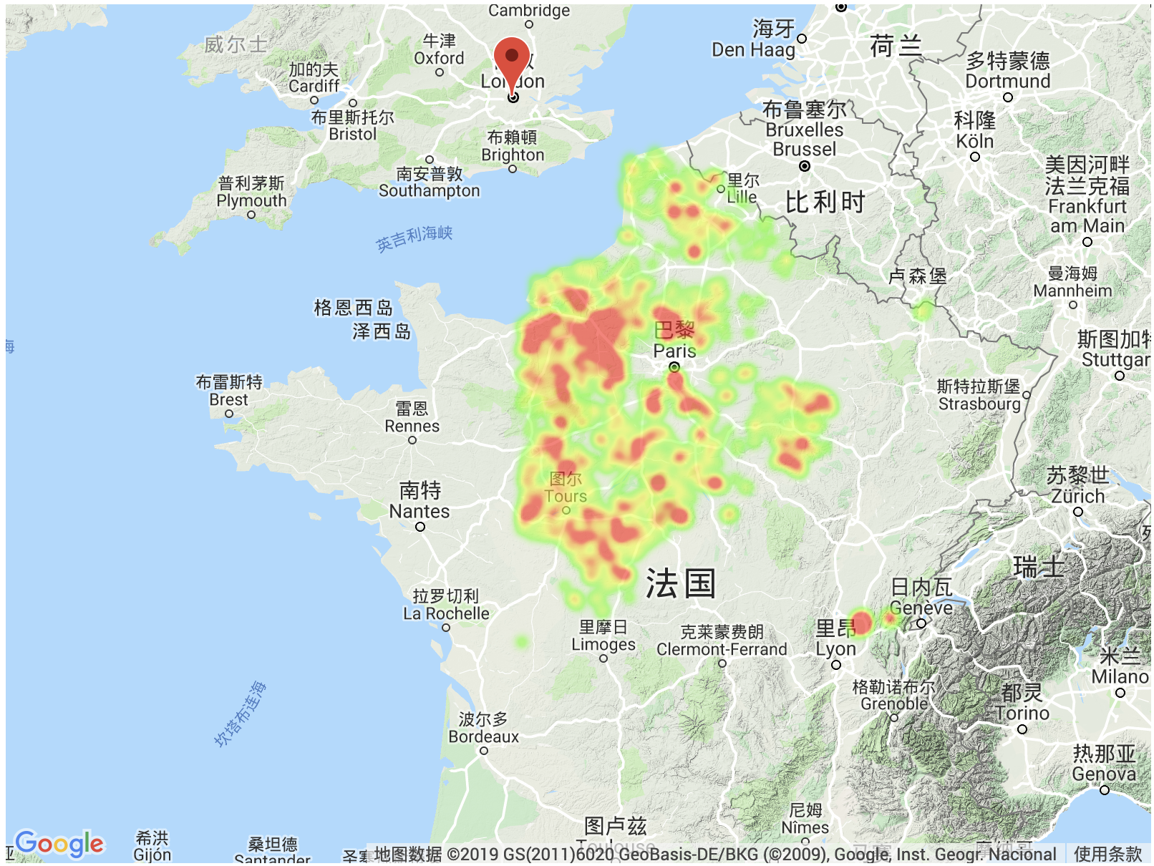
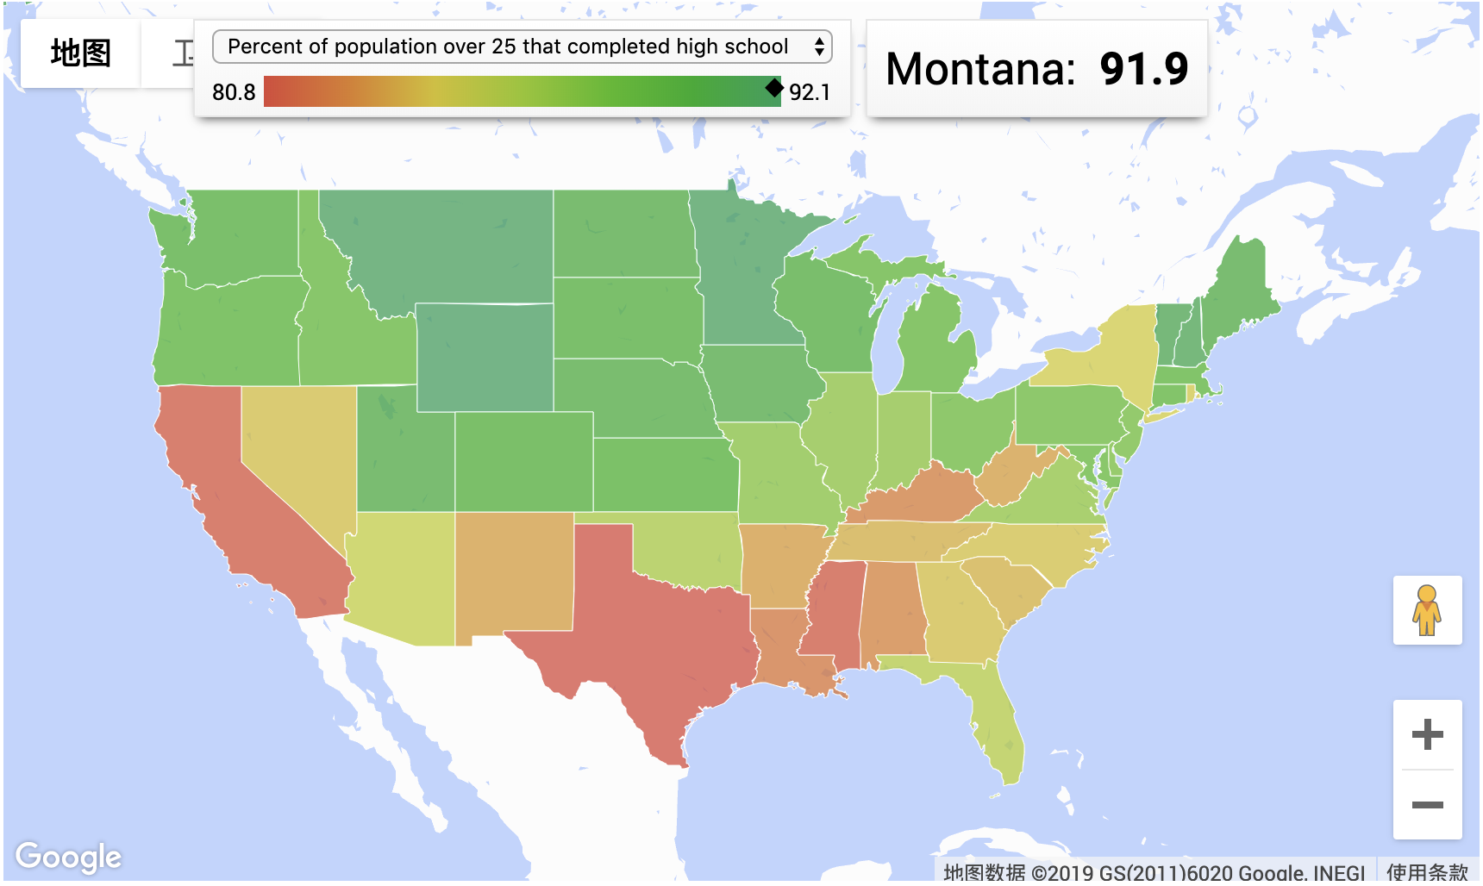
Analysis with Visualization - Charts
Cluster maps
Heat maps
Classification maps
5 Days

Slide 15
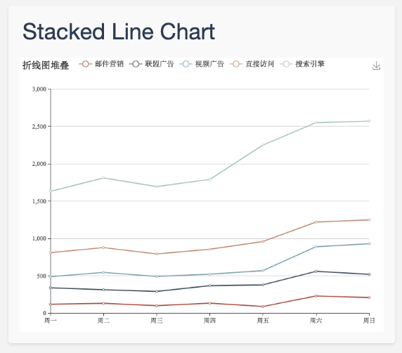
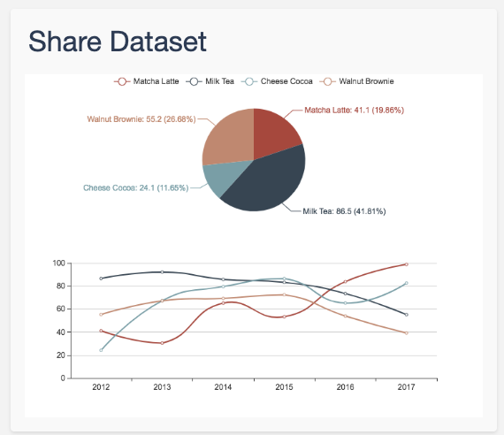
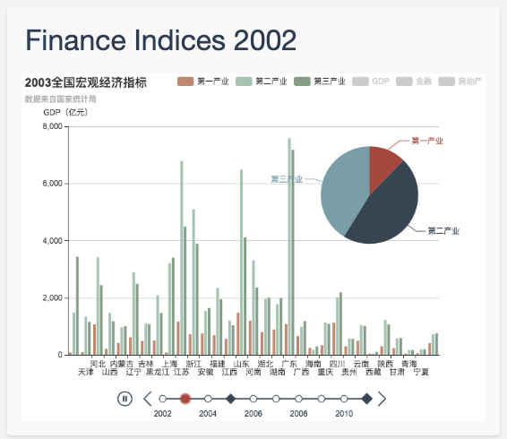
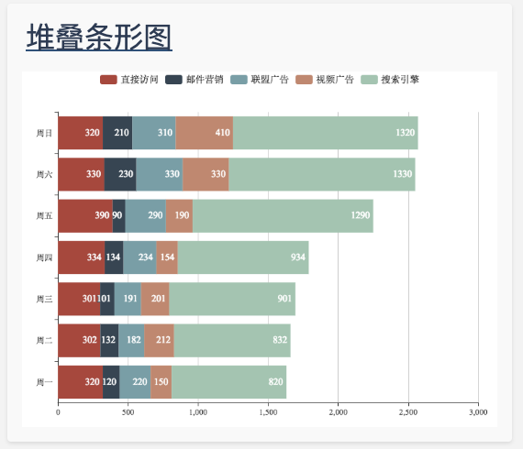
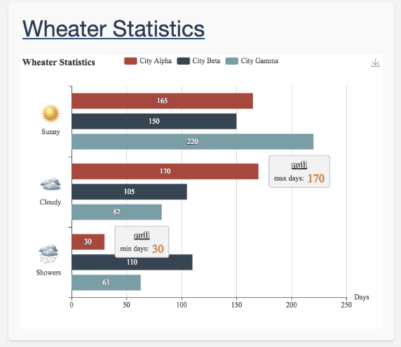
Analysis with Visualization - Charts
Line Chart
Bar Chart
Pie Chart
6 Days

Slide 16
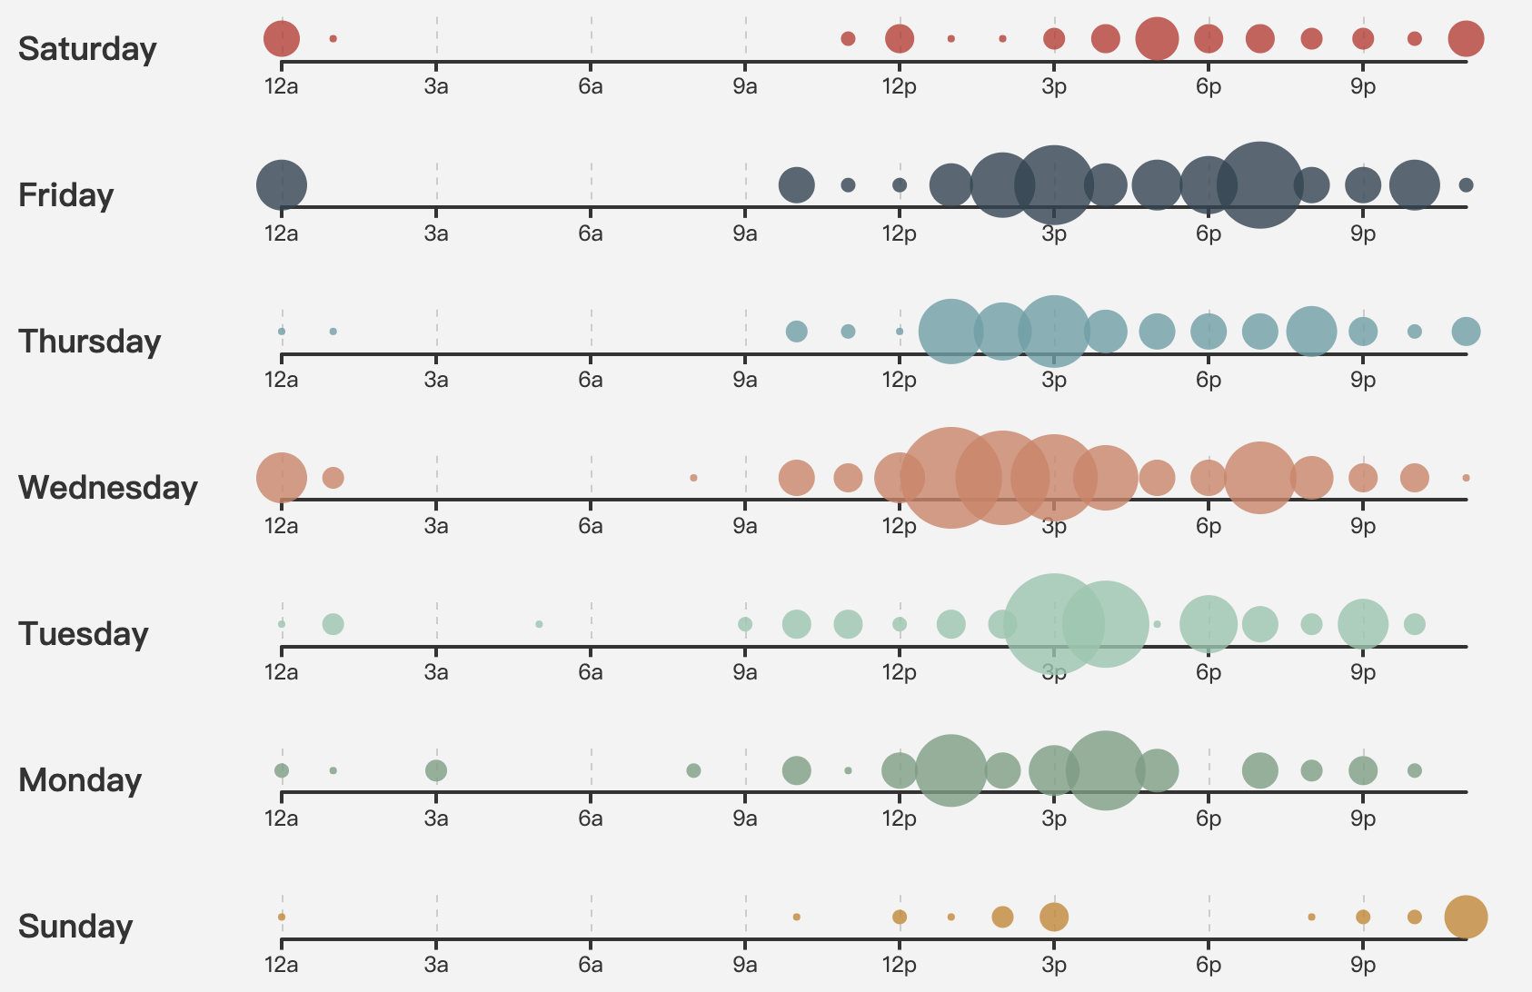
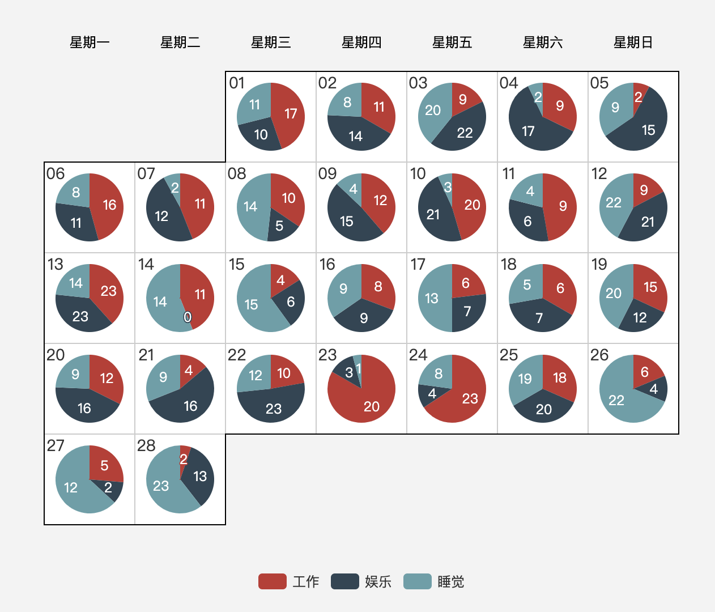
Analysis with Visualization - Charts
(Pie Chart)
Scatter Chart
3 Days

Slide 17

Risks & Problems
Dataset is tremendous, so a better data handling method is needed for asynchronous loading, or the loading speed would be very slow.
An appropriate user interface is a must as there are too many data locating in the almost same position to distinguish one from another.
Baidu Map, which we are pretty familiar with in China, does not support both French and English. It doesn’t matter to the static charts we want. But in order to make the system more interactive, we have to spend more time learning API of Google Maps and Openstreetmap. The trouble is Google Maps is not free anymore, we have to bind our credit card, which is risky.

Slide 18
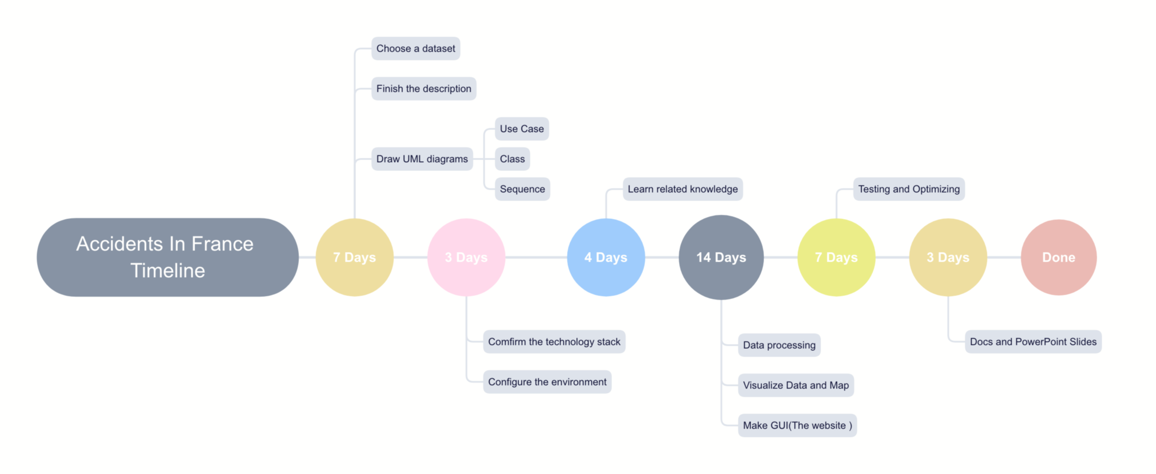
Timeline
Tasks | Duration
Choose a dataset Draw UML diagrams | 1 week
Confirm the technology stack Configure the environment | 3 days
Learn related knowledge | 4 days
Data processing Make GUI (The website) | 2 weeks
Testing and Optimizing | 1 week
Docs and PowerPoint Slides | 3 days
Total | Around 38 days

Slide 19
THANK YOU
Group 4
2019.5.14
2019

